Slide 1
Keagan Erasmus
Agora E-commerce Site

Slide 2
Technical Features

Slide 3
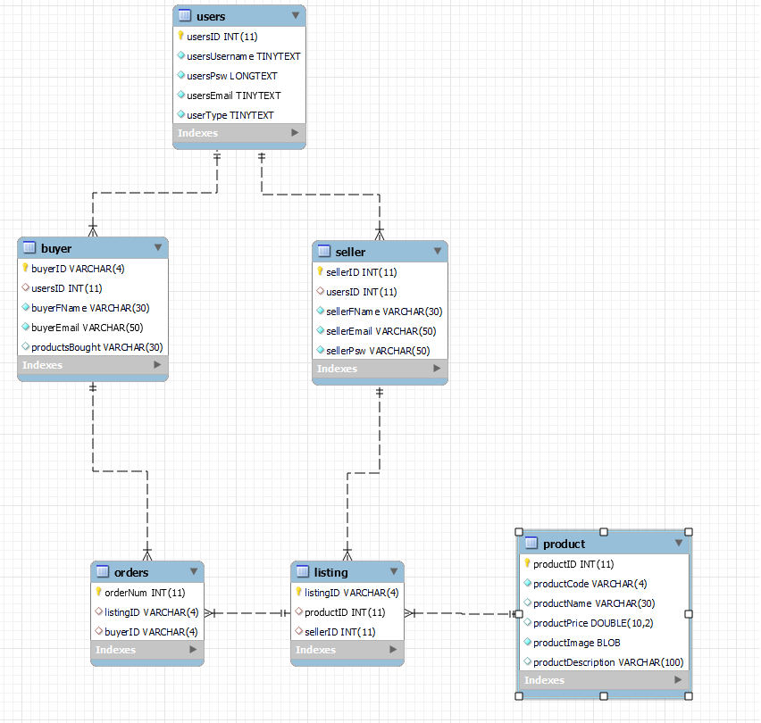
Database Tables

Slide 4
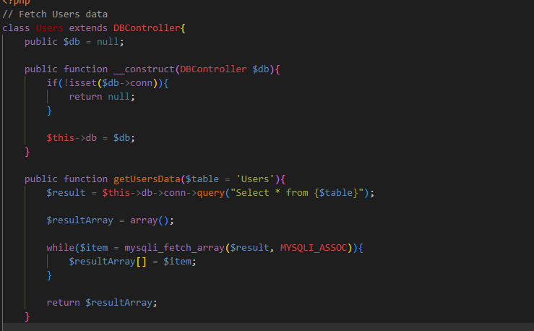
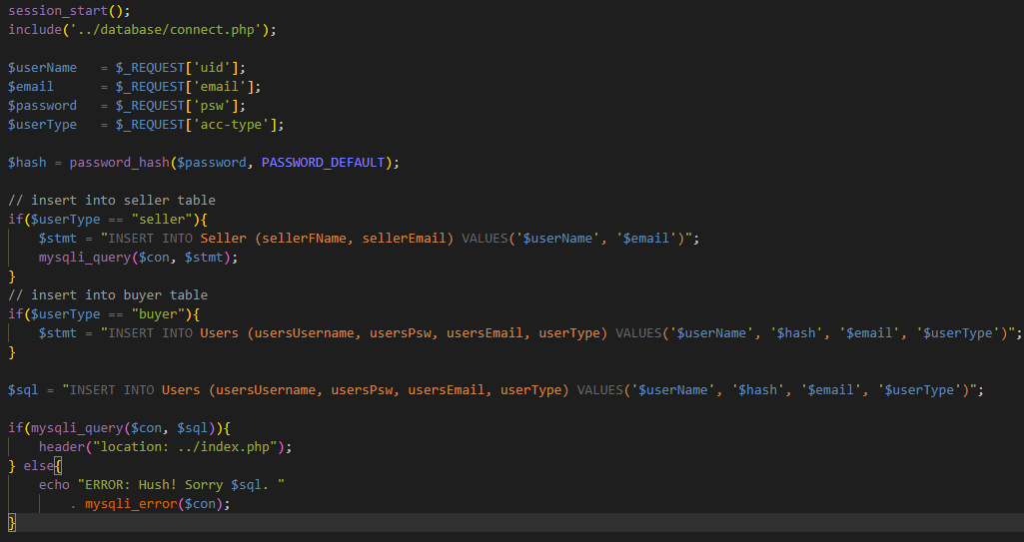
Gets Data and inserts Data Simple Select and display query

